Slide 1
Software Quality Assurance and Reviews
Sobia Usman

Slide 2
Software Quality Assurance and Reviews
Software development Process → Different documents (SRS+ DDS)
The system analysts & development team leaders who prepared the document will check it repeatedly→ in order to detect any possible error that might have entered.
Others – such as peers, experts, and customer’s representatives– reviewing the product and detecting the errors unnoticed by the development team.

Slide 3
Software Quality Assurance and Reviews
As defined by IEEE , a review process is:
“A process or meeting during which a work product, or set of work products, is presented to project personnel, managers, users, customers, or other interested parties for comment or approval.”
Reviews have special importance in the SQA process
They provide early detection and prevent the passing of design and analysis errors “downstream "to stages where error detection and correction are much more costly.

Slide 4
Review Methodologies
Several methodologies can be implemented when reviewing documents.
Formal design Reviews
Peer Reviews (inspections and walkthroughs)
Expert opinions

Slide 5
Review objectives- Direct
To detect analysis and design errors as well as subjects where corrections, changes and completions are required with respect to the original specifications and approved changes.
To identify new risks likely to affect completion of the project.
To locate deviations from templates and style procedures and conventions. Correction of these deviations is expected to contribute to improved communication and coordination resulting from greater uniformity of methods and documentation style
To approve the relevant document/Product…. Approval allows the team to continue to the next development phase.

Slide 6
Review objectives- Indirect
To provide an informal meeting place for exchange of professional knowledge about development methods, tools and techniques.
To record analysis and design errors that will serve as a basis for future corrective actions.
The corrective actions are expected to improve development methods by increasing effectiveness and quality, among other product features.

Slide 7
Formal design reviews
Formal design reviews, variously called …“formal technical reviews (FTR)”
Necessary for approval of the product.
Formal reviews may be conducted at any development milestone→ completion of an analysis or design document, whether that document is a requirement specification or an installation plan.

Slide 8
Formal design Reviews
Some common formal reviews
DPR – Development Plan Review
SRSR – Software Requirement Specification Review
PDR – Preliminary Design Review
DDR – Detailed Design Review
DBDR – Data Base Design Review…etc

Slide 9
Formal design Reviews
Formal design reviews will focus on
The participants
The prior preparation
The DR session
The recommended post DR activities
The participants in a DR
All DRs are conducted by a review leader and a review team.
The choice of appropriate participants is of special importance because of their power approve or disapprove a product.

Slide 10
Formal design Reviews
Review leader:
Appointment of an appropriate review leader is a major factor affecting the FR’s success
Certain characteristics are to be looked for in a candidate for this position:
Knowledge and experience in development of projects of the type reviewed.
A good relationship with the project leader and his team.
Candidates for review team leadership include
The development department’s manager
The software engineer
The head of the software quality assurance unit

Slide 11
Formal design Reviews (DRs)
The review team:
A review team of three to five members is expected to be an efficient team
Should be selected from among the senior members of the project team
Senior professionals assigned to other projects and departments
Customer–user representatives
Software development consultants.

Slide 12
Formal design Reviews
Preparations for a DR:
The main tasks of the review leader in the preparation stage are:
To appoint the team members
To schedule the review sessions
To distribute the document among the team members (hard copy, electronic file, etc.).
Review team preparations:
Review the document
list their comments prior to the review session.

Slide 13
Formal design Reviews
Development team preparations:
Prepare a short presentation of the document.
The presentation should focus on the main professional issues awaiting approval
The DR session:
A typical DR session agenda includes:
A short presentation of the design document.
Comments made by members of the review team.
Comments are discussed to determine the required actions (corrections, changes and additions) that the project team has to perform.
Decisions about the design product (document), which determines the project’s progress.

Slide 14
Formal design Reviews (FRs)
These decisions can take three forms:
Full approval
Enables immediate continuation to the next phase of the project.
Partial approval
Approval of immediate continuation to the next phase for some parts of the project, with major action items (corrections, changes and additions) demanded for the remainder of the project.
Continuation to the next phase of these remainder parts will be permitted only after satisfactory completion of the action items.
Denial of approval
Demands a repeat of the DR. This decision is applied in cases of multiple major defects, particularly critical defects.

Slide 15
Formal design Reviews (DRs)
Post-review activities:
The DR team or its representative is required to follow up performance of the corrections and to examine the corrected sections.
The DR report
The report’s major sections contain:
A summary of the review discussions.
The decision about continuation of the project.
A full list of the required actions – corrections, changes and additions that the project team has to perform.
For each action item, the anticipated completion date and project team member responsible are listed.
The name(s) of the review team member(s) assigned to follow up performance of corrections.

Slide 16
The follow-up process
The person appointed to follow up the corrections, in many cases the review leader, is required to determine whether each action item has been satisfactorily accomplished .
Follow-up should be fully documented to enable clarification of the corrections in the future, if necessary.

Slide 17
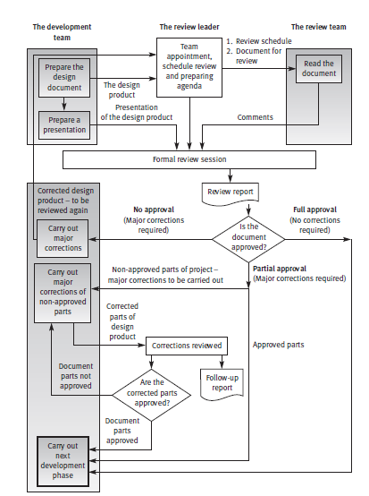

Slide 18
